Slide 1
EDA Project -FACE BOOK DATA Analysis
- VAISHNAVVI M S

Slide 2
Agenda
Introduction
Business Questions Identified
Approach and Findings
Conclusion
Actionable Insights

Slide 3
Introduction
Dataset used is Face Book dataset.
The purpose of this data analysis is to understand the pattern to improve the business functionality by identifying useful users and provide correct recommendations to them.

Slide 4
Business Questions Identified
Distribution of users based on age
Number of users based on age
Average number of friends based on gender and age
Average number of likes received based on gender and age
Calculate likes per day based on gender
Number of hours spent based on gender and age
Categorize the likes received based on age and gender
Co-relation among likes

Slide 5
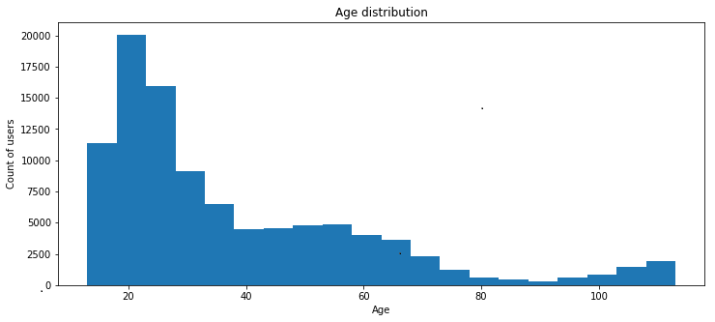
Distribution of users based on age
Heavy usage is seen in age of 20-30

Slide 6
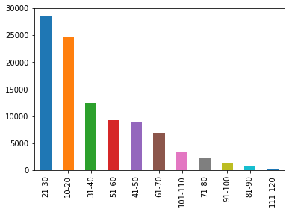
Number of users based on Age

Slide 7
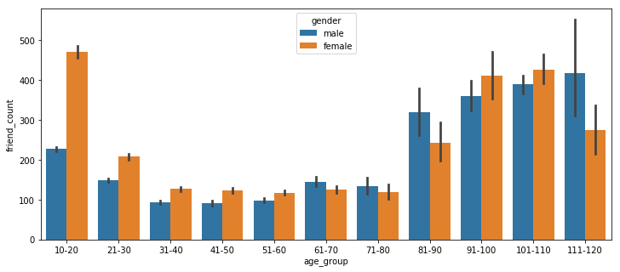
Average number of friends based on gender and age
Female users are more active on Face book.

Slide 8
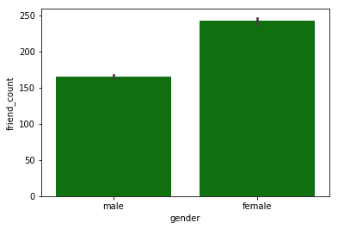
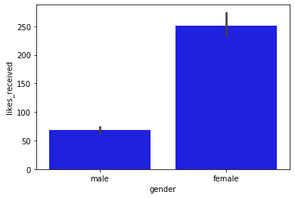
Friends Count and likes received based on gender
Friends count for female is more
Likes received is more for female

Slide 9
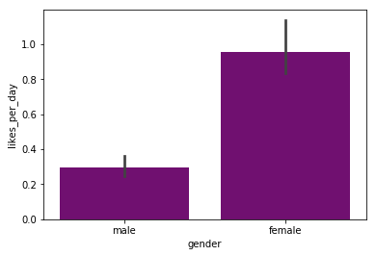
Calculate likes per day based on gender
Female has more likes than male

Slide 10
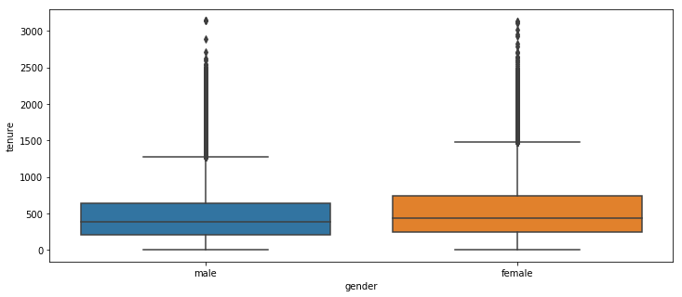
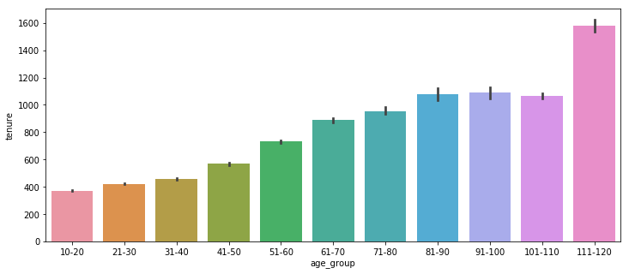
Number of hours spent On Face book based on gender and age

Slide 11
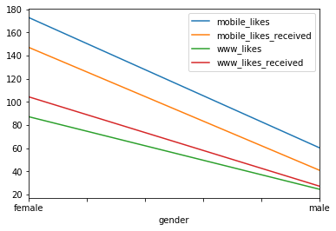
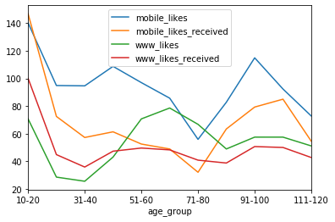
Categorize the likes received based on age and gender
Female has more likes in all categories.
Age group10-20 has more likes

Slide 12
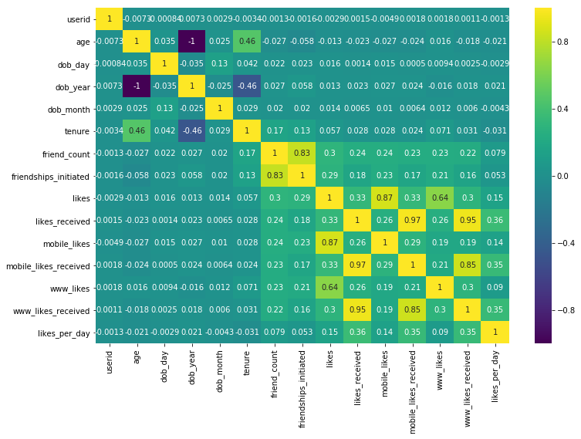
Co-relation among likes

Slide 13
Conclusion
Interesting facts analysed :
Male users are more but female are more likely to be active in face book
Tenure for old adults are more but likes received for young people are more irrespective of tenure.

Slide 14
Actionable insights
In order to increase the users on face book , need to give more page **suggestions or recommendations** to the users searches
There are interaction challenges to users aged from middle age and above, can improve design of social network platform to make old adults to play better in Face book.
To attract male users , can introduce more games and movies according to the trend.

Slide 15
THANK YOU☺

